Slide 1
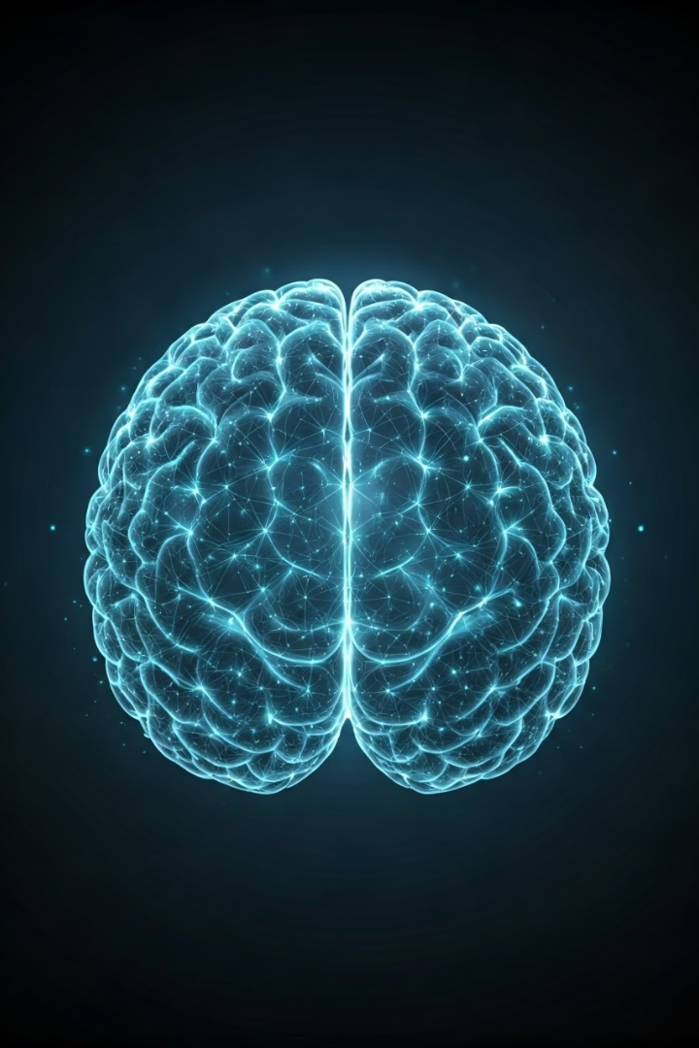
Brain Tumor Detection Using Machine Learning
This presentation outlines a machine learning-based approach for early and accurate brain tumor detection from MRI images. Our research utilizes a Convolutional Neural Network (CNN) to classify tumors, aiming to improve patient outcomes through efficient diagnostics.

Slide 2
Meet Our Research Team
Md. Mehedi Hasan Polas
Tridib Sarkar
Sajin Mahmud Arpon
Talha Hossain Sifat
Dept. of Computer Science & Engineering
American International University- Bangladesh
22-46566-1@student.aiub.edu
Dept. of Computer Science & Engineering
American International University- Bangladesh
22-46444-1@student.aiub.edu
Dept. of Computer Science & Engineering
American International University- Bangladesh
22-46629-1@student.aiub.edu
Dept. of Computer Science & Engineering
American International University- Bangladesh
22-46344-1@student.aiub.edu
Supervised by
Prof. Dr. Md. Asraf Ali

Slide 3
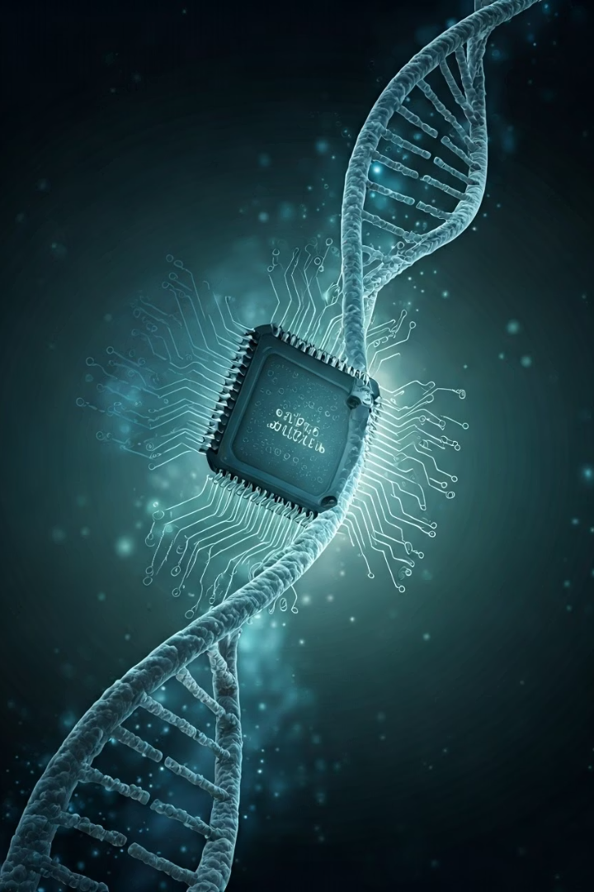









Presentation Agenda
Problem Background: Critical Need
Motivation: Advancing Diagnostics
Objective: Simple, Fast, Accurate
Methodology: Building the CNN Model
Data Collection and Validation
Data Preprocessing and Feature Extraction
Classification Algorithms and Data Analysis
Results and Discussion
Conclusion and Future Recommendations

Slide 4
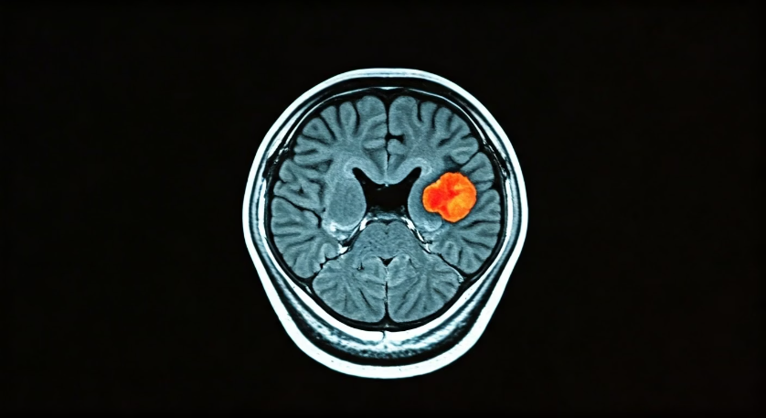
Problem Background: The Critical Need for Early Detection
Brain Tumors
Type → They can be either cancerous (malignant) or non-cancerous (benign).
Definition → Brain tumors are abnormal growths of cells in the brain.
Function Disruption → These tumors interfere with normal brain function.
Headaches → One of the most common symptoms is frequent or severe headaches.
Memory Loss & Seizures → Tumors may cause memory problems and seizures.
Behavioral Changes → They can lead to changes in behavior or personality by pressing on brain tissues.
Early Detection is Key
Early and accurate detection through advanced diagnostic methods is crucial. It significantly improves treatment effectiveness and patient survival rates, making this a vital area in modern healthcare research.

Slide 5
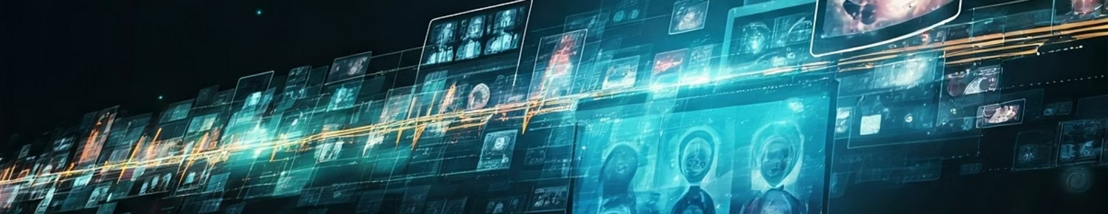



Motivation: Advancing Diagnostics with Machine Learning
Improved Accuracy
Efficient Analysis
Data Utilization
Machine learning and deep learning approaches enhance the precision of brain tumor classification.
Hybrid methods integrate fuzzy thresholding with deep learning for faster and more accurate detection.
Transfer learning and publicly available datasets optimize model training and performance.

Slide 6

Objective: A Simple, Fast, and Accurate System
Develop a System
Quick & Accurate Results
Our primary goal is to create a straightforward and rapid machine learning system for brain tumor detection.
The system aims to provide fast and precise results to assist medical professionals in their diagnostic process.
Broad Applicability
Designed for use in hospitals, clinics, rural health centers, and mobile/cloud platforms to enhance early detection and treatment planning.

Slide 7
Model Architecture

Slide 8
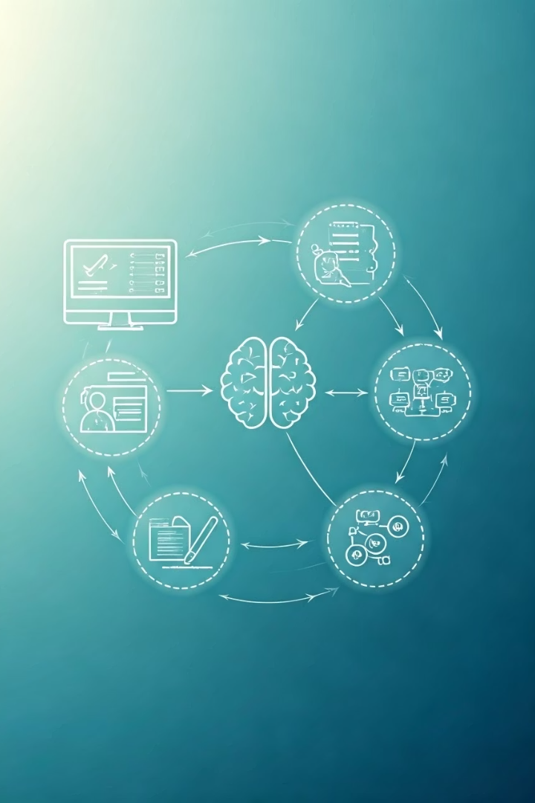
Methodology: Building the CNN Model
1
Data Collection & Preprocessing
Gathering and preparing brain tumor MRI images for model training.
2
CNN Model Construction
Building a Convolutional Neural Network using Keras Sequential API.
3
Training & Validation
Training the model on preprocessed data and validating its performance.
4
Evaluation & Selection
Measuring performance with metrics like accuracy, precision, recall, and F1-score to select the best model.

Slide 9
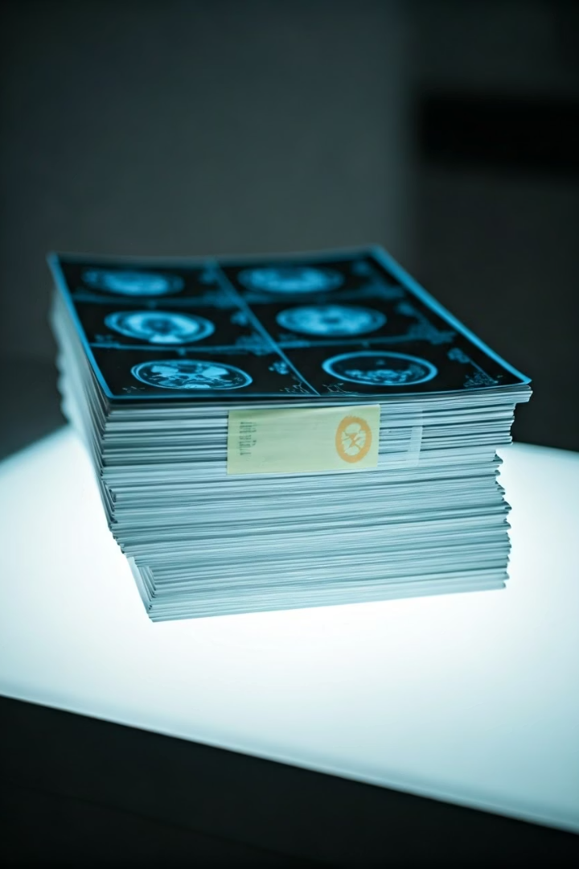



Data Collection and Validation
Data Source
The dataset was collected from Kaggle, containing 253 brain MRI images: 155 with tumors and 98 without.
Image Format
Images are in grayscale and clearly labeled ("yes" for tumor, "no" for no tumor) for easy processing.
Validation Process
Data validation ensured completeness, correctness, proper organization, and ethical standards, removing any unclear or missing images.

Slide 10
Data Preprocessing and Augmentation
Feature Extraction
The CNN's convolutional layers extract key features such as edges, textures, and shapes, while max pooling reduces the feature map size.
Normalization
Pixel values are scaled to a 0–1 range by dividing by 255, ensuring stable and efficient model training.
Resizing & Conversion
Images are resized to 224x224 pixels and converted to RGB format for uniformity in training.
Data Augmentation
Horizontal and vertical flipping were applied to the MRI images to increase data diversity.

Slide 11




Classification Algorithms and Data Analysis
CNN Model
Classification
A Convolutional Neural Network with convolutional and max pooling layers for feature extraction.
1
Flattened features passed through dense layers with a sigmoid activation for binary classification.
2
Performance Analysis
Training
4
Evaluated using accuracy, loss, precision, recall, F1-score, and confusion matrix.
Trained using Adam optimizer and binary cross-entropy loss function for accurate results.
3

Slide 12
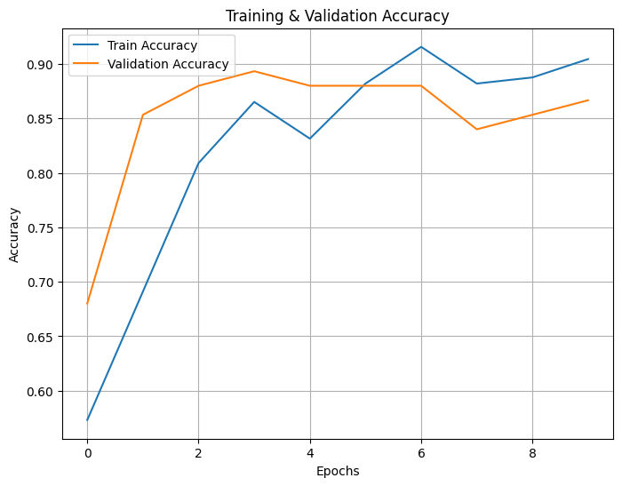
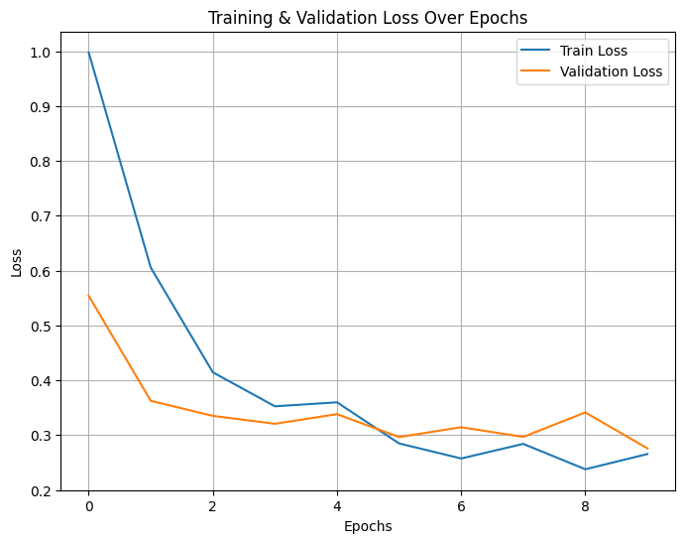
Training curves
Accuracy Curve:
The training accuracy steadily improved and crossed 90% by the final epoch. Validation accuracy stayed around 88–89% but slightly dropped after epoch 6, indicating potential overfitting. Overall, the model performed well on both datasets.
Loss Curve:
Training loss decreased from 1.0 to about 0.26, while validation loss stayed between 0.28 and 0.36. Minor fluctuations appeared after epoch 4, but the overall low loss values indicate effective learning and stable model performance.

Slide 13
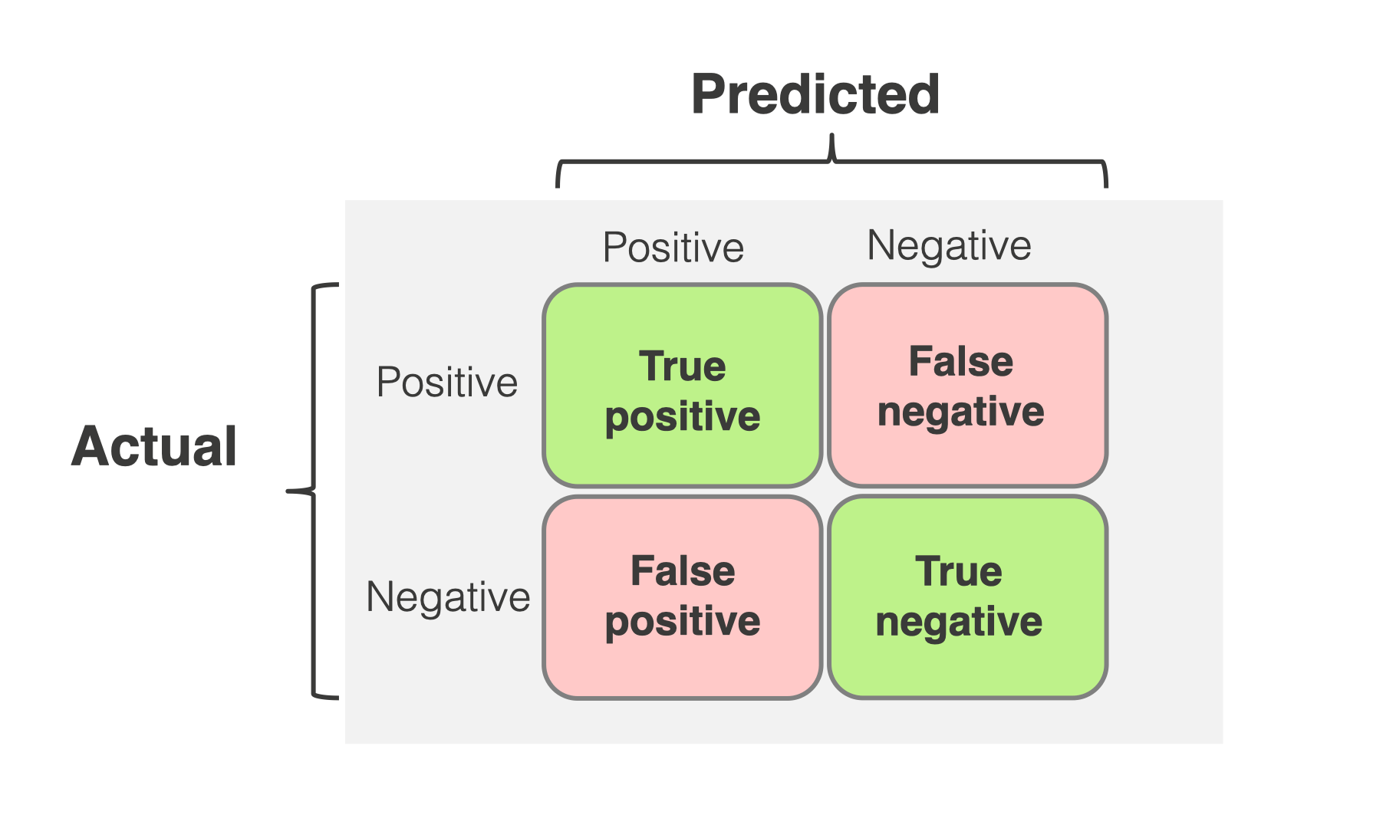
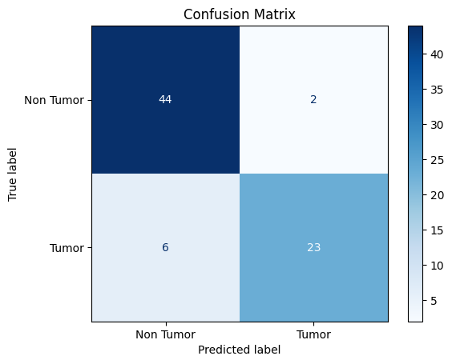
Results and Discussion
The confusion matrix highlights the performance of the CNN model in brain tumor detection. It accurately classified 44 non-tumor cases and 23 tumor cases. However, it misclassified 2 non-tumor images as tumor and 6 tumor images as non-tumor. These results indicate strong precision in detecting non-tumor cases and generally reliable tumor detection, supporting the model's effectiveness for medical image classification tasks.

Slide 14
Results and Discussion
89%
0.89
Accuracy
F1-Score
Overall accuracy of the CNN model in brain tumor detection.
Indicates robust performance in distinguishing tumor presence.
44
23
True Negatives
True Positives
Correctly predicted non-tumor cases.
Correctly predicted tumor cases.
The CNN model achieved strong results, effectively identifying tumor and non-tumor images. Training accuracy steadily improved, while validation accuracy remained high, indicating reliable performance. The confusion matrix further validated the model's ability to correctly classify cases.

Slide 15

Conclusion and Future Recommendations
Domain Knowledge
Advanced Methods
Integrating domain-specific features like tumor size and location may increase accuracy.
Dataset Expansion
Incorporating transfer learning with pre-trained models can further improve performance.
Strong Performance
Future work should include more images with diverse tumor types to enhance model generalization.
The CNN model demonstrated robust performance with 89% accuracy and an F1-score of 0.89 in brain tumor detection.

Slide 16
References
[1] Paromita Kundu, Chandana Mohanty, and Sanjeeb Sahoo. Retrac tion. retraction notice to ”antiglioma activity of curcumin-loaded lipid nanoparticles and its enhanced bioavailability in brain tissue for effective glioblastoma therapy” [acta biomaterialia 8 (2012) 2670-2687]. Acta Biomater, 9:7074, 06 2013.
[2] S Gopal Krishna Patro, Nikhil Govil, Surabhi Saxena, Brojo Kishore Mishra, Abu Taha Zamani, Achraf Ben Miled, Nikhat Parveen, Hashim Elshafie, and Mosab Hamdan. Brain tumor classification using an ensemble of deep learning techniques. IEEE Access, 12:162094–162106, 2024.
[3] Nashaat Hassan and Wadii Boulila. Efficient approach for brain tumor detection and classification using fuzzy thresholding and deep learning algorithms. IEEE Access, PP:1–1, 01 2025.
[4] Bibat Thokar, Binod Sapkota, Babu R. Dawadi, and Shashidhar R. Joshi. Medical image segmentation for anomaly detection using deep learning techniques. IEEE Access, 12:185460–185481, 2024.
[5] Raja Anwar, Mohammad Abrar, and Faizan Ullah. Transformative transfer learning for mri brain tumor precision: Innovative insights. IEEE Access, PP:1–1, 01 2025.
[6] Anees Tariq, Muhammad Munwar Iqbal, Muhammad Javed Iqbal, and and Iftikhar Ahmad. Transforming brain tumor detection empowering multi class classification with vision transformers and efficientnetv2. IEEE Access, 13:63857–63876, 2025.
[7] Navoneel Chakrabarty. tion. Brain mri images for brain tumor detec https://www.kaggle.com/datasets/navoneel/brain-mri-images-for brain-tumor-detection, 2023. Accessed: 2025-05-24

Slide 17

Questions and Answers
Thank you for attending our presentation on brain tumor detection. We appreciate your interest in our research.
We are now open to any questions you may have about our methods, findings, or future recommendations. Your inquiries are welcome.

